Slide 1
CPS 235 Object Oriented Programming Paradigm
Overloading Stream Insertion and Stream Extraction Operator
Lecturer Rabia Khan

Slide 2
Introduction
Until now, the example programs of previous sections provided very little interaction with the user, if any at all. Using the standard input and output library, we will be able to interact with the user by printing messages on the screen and getting the user's input from the keyboard.
C++ uses a convenient abstraction called streams to perform input and output operations in sequential media such as the screen or the keyboard. A stream is an object where a program can either insert or extract characters to/from it. We do not really need to care about many specifications about the physical media associated with the stream - we only need to know it will accept or provide characters sequentially.
The standard C++ library includes the header file iostream, where the standard input and output stream objects are declared

Slide 3
Standard Output (cout)
By default, the standard output of a program is the screen, and the C++ stream object defined to access it is cout.
cout << "Output sentence"; // prints Output sentence on screen
cout << 120; // prints number 120 on screen
cout << x; // prints the content of x on screen
The << operator inserts the data that follows it into the stream preceding it.

Slide 4
Standard Input(cin)
The standard input device is usually the keyboard. Handling the standard input in C++ is done by applying the overloaded operator of extraction (>>) on the cin stream. The operator must be followed by the variable that will store the data that is going to be extracted from the stream. For example:
int age;
cin >> age;
The first statement declares a variable of type int called age, and the second one waits for an input from cin (the keyboard) in order to store it in this integer variable.
cin can only process the input from the keyboard once the RETURN key has been pressed. Therefore, even if you request a single character, the extraction from cin will not process the input until the user presses RETURN after the character has been introduced.
CPS235:Strings

Slide 5
What about ADTs?
Review the following statement:
  cout << x;
Think of “<<“ as an operator which has an object ‘cout’ on its lefthand side and an ‘int’ type on right hand side. What happens if instead of a built in data type, this data type is an Abstract Data Type? How can I make sure the following statement executes fine:
  cout << d1; //where d1 is an object of type Distance
By overloading the << operator, you can! Overloading operator<< is similar to overloading operator+ (they are both binary operators), except that the parameter types are different.
Consider the expression cout << d1. If the operator is <<, what are the operands? The left operand is the cout object, and the right operand is your Distance class object. cout is actually an object of type ostream. Therefore, our overloaded function will look like this:
friend ostream& operator<<(ostream &out, Distance &d1);
CPS235:Strings

Slide 6
Overloading ‘<<‘
friend ostream& operator<<(ostream &out, Distance &d1);
Is this function a member function of the class? Is the left operand always the object of the class?
Why is this function a friend function?
Notice the return type. Why are we returning an object of type ostream?
  The answer is that we do this so we can "chain" output commands together, such as
  cout << cPoint << endl;
Change the return type of this friend function to void, what will happen?
CPS235:Strings

Slide 7
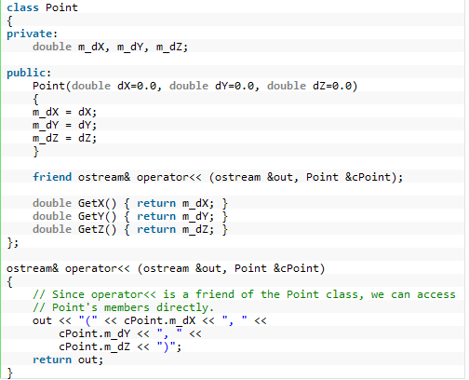
Example
CPS235:Strings

Slide 8
Important Point
Any time we want our overloaded binary operators to be chainable in such a manner, the left operand should be returned
CPS235:Strings

Slide 9
Overloading ‘>>’
It is also possible to overload the input operator. This is done in a manner very analogous to overloading the output operator. The key thing you need to know is that cin is an object of type istream.
Write the definition for function that overloads ‘>>’ operator for previous class Point Example
CPS235:Strings

Slide 10
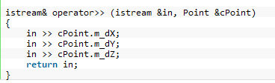
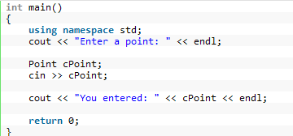
Overloading ‘>>’
Now in main() you may write:
CPS235:Strings

